Slide 1
CSE315:Introduction to Data Science
WEEK-5

Slide 2
Inference and Estimation
Guess is the meaning of the word inference. When the population parameters are estimated from the data obtained from the sample through statistical method it is called statistical inference.
For example, you collected sample data on the monthly income of 200 bus drivers, from which you can find out the average monthly income of 200 bus drivers. If you want to know based on this information what will be the average income of bus drivers all over Bangladesh, this is the information. Method of estimating population information based on sample information.

Slide 3
Inference and Estimation
The information obtained from the sample is called sample statistic. Statistics is expressed by English letters such as mean is expressed by X, standard deviation is expressed by S.
Population information is called population parameter. Parameters are expressed by Greek letters, such as mean μ and standard deviation σ.

Slide 4
Types of Inference
Estimation- Estimation is a method of extracting numerical data of population parameters from sample data.
Types of Estimation- a) Point Estimation
b) Interval Estimation
Hypothesis Testing- Simply, a hypothesis is a hypothetical claim about population. However, this hypothetical claim must be mathematically verifiable.
Types- Null Hypothesis and Alternative Hypothesis

Slide 5
Point Estimation
In point estimation a certain value of the population parameter is found. In this case, sample information is considered as population information.
Ways- Method of Moments and Maximum Likelihood

Slide 6
Interval Estimation
Estimating the value of a population parameter within a certain range or range, assuming there will be some errors in the point estimate, is called an interval estimate. Interval estimation consists of a confidence level such as 90% confidence level, 95% confidence level, 99% confidence level etc.
Interval estimation = Point estimation +/- error margin

Slide 7
Two ways to estimate interval estimation
Interval estimation is mainly done in two ways. Z distribution is followed when population standard deviation σ is known and T distribution is followed when σ is unknown.

Slide 8
Hypothesis Testing
The hypothesis is a very obscure and complex part of the world of statistics. Simply, a hypothesis is a hypothetical claim about population. However, this hypothetical claim must be mathematically verifiable.
Hypotheses can be of two types:
Null and Alternate Hypothesis

Slide 9
Null Hypothesis
Null Hypothesis- Null hypothesis is a claim regarding population which is initially taken as true until it is proved to be false. The null hypothesis is expressed by H0. Expression of null hypothesis may have =, <= or> = sign.
Alternative Hypothesis- If the null hypothesis is proved to be false then another hypothesis is kept as an alternative which is considered to be true, this hypothesis is called Alternative Hypothesis. Alternative hypotheses are expressed by HA. Alternative hypotheses cannot contain expressions of null hypotheses (=, <= or> =). In that case the expression of alternative hypothesis may be ≠,>, <etc.

Slide 10
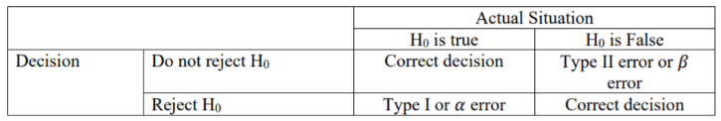
Hypothesis Testing
Hypothesis testing is the process of checking whether a hypothesis is correct. In hypothesis testing, we can reject or accept a null hypothesis.
When testing a hypothesis, correct assumptions may be considered incorrect and incorrect assumptions may be considered correct. This type of error is called hypothesis testing error.
This error can be of two types:
Type I Error - When a true null hypothesis is rejected, it is called a Type I Error.
Type II Error- When a false null hypothesis is not rejected, it is called Type II Error.

Slide 11
Hypothesis Testing (z test and t test)
z test and t test - we use z distribution when the value of population standard deviation is known and such test is called z test.
On the other hand, when the value of population standard deviation is unknown, we use t distribution and such a test is called t test.

Slide 12
z test and t test
Conditions for z and t test:
Sample size should not be less than 30
Follow the normal distribution if the population size is less than 30.
Otherwise follow the non parametric method
σ value is known?
Z test
t test

Slide 13
P-value
p-value- it is a probability value. When testing a hypothesis with p-value, if significance (significance level) is greater than p-value, then null hypothesis is rejected, whereas if it is less than p-value, then null hypothesis is not rejected.
Steps to test hypothesis in p-value method,
Step-1: Determining Null and Alternative Hypothesis
Step-2: Determine which distribution to follow
Step-3: Find the value of p-Value
Step-4: Making a decision

Slide 14
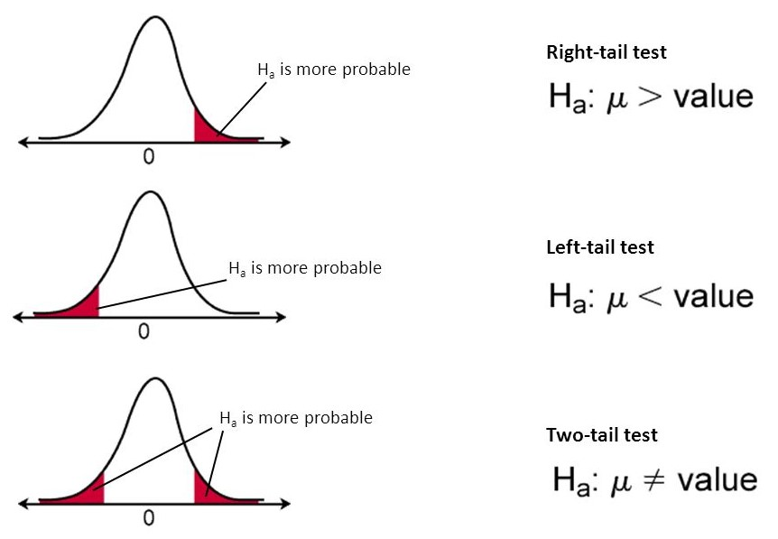
One Tail and Two Tail Tests
One Tail and Two Tail Tests - In Hypothesis Testing, we see if the value of alpha significance (significance level) exceeds the p-value. That is, if the value of is within the non-rejection area (white part), we will not reject the null hypothesis.
On the other hand, if the value of alpha exceeds the non-rejection area and reaches the rejection area (red part), then we will reject the null hypothesis.

Slide 15
Mathematical example-1 of z test
One company claims that it takes employees an average of 90 minutes to learn how to use new machineries. The company's supervisor recently collected samples from 20 employees to find out if it took employees less than 90 minutes or more to learn to use a newly added machine.
The average time to learn how to use their newly connected machine in that sample was 75 minutes. It is known from the previous information that the learning duration of the employees using the machine follows the normal distribution and in this case the standard deviation is 6 minutes. Now verify the claim in the case of alpha = .01 (i.e. 99% confidence level).

Slide 16

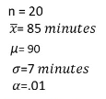
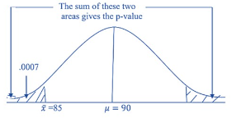

Mathematical example-1 of z test
Step-1: Determining Null and Alternative Hypothesis
Step-2: Determine which distribution to follow
As Sample size is less than 30 but standard deviation
is known so we follow the Normal distribution
Step-3: Find the value of p-Value
According to Z z-table, p value will be .0007 and it is a two-tail test so p-value will be double
Step-4: Making a decision
Alpah=.01, p value is greater than .0014 so we reject null hypothesis. So new employees need to learn the machineries which is not 90 minutes, rather it take less or greater than 90 minutes.

Slide 17
Mathematical example-2 of z test
The mayor of a city estimates that the average value of the assets of families living in his city is at least, 300,000. To verify the validity of this claim / assumption, he collected data from 25 families through random samples. The average wealth of the families was found to be 26,000 from the sample. Past research has shown that the population standard deviation in the distribution of wealth to the people of that city is 60,000. Now verify the veracity of the mayor's claim at 2.5% level of synapses.

Slide 18


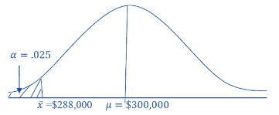

Mathematical example-2 of z test
Step-1: Determining Null and Alternative Hypothesis
Step-2: Determine which distribution to follow
As Sample size is less than 30 but standard deviation
is known so we follow the Normal distribution
Step-3: Find the value of p-Value
According to Z z-table, p value will be .2266
Step-4: Making a decision
Alpah=.025, which is less than p value (.2266) so we will not reject null hypothesis. So mayor claim is right.

Slide 19
Mathematical example-1 of t test
One expert claims that the average oxygen intake of those who exercise regularly is higher than the average oxygen intake of older adults. Previous research has shown that the average oxygen intake in normal adults is 36.6 ml / kg. You wanted to verify the validity of this claim. That's why you randomly selected 15 people who exercised regularly and looked at the data collected from them, taking an average of 40.6 ml / kg of oxygen. The standard deviation of the sample is 8 ml / kg. It is already known that the amount of oxygen intake in adults follows the normal distribution. Now you need to verify the validity of this claim at 5% Level of Significance.

Slide 20
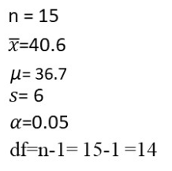


Mathematical example-1 of t test
Step-1: Determining Null and Alternative Hypothesis
Step-2: Determine which distribution to follow
As Sample size is less than 30 but standard deviation
is unknown so we follow the t distribution
Step-3: Find the value of p-Value
According to t-table, df=14 and we see that the value of 2.517 resides between 2.145 and 2.624, so the p-value is accordingly .025 and .01. so we can write .01<p-value< .025
Step-4: Making a decision
Alpah=.05, which is greater than p value so we will reject null hypothesis.

Slide 21
Probability
Probability is the probable mathematical measure of the occurrence of an event. The probability of this incident is how much the head is likely to rise when tossing.
Probability = favorable event / total event
For example, in the game of Ludu, if you give a move, what is the probability of getting that?
The total number of events in Ludu's dice is 6 (1,2,3,4,5, and 6) and the favorable event is 1 i.e. 6 rising events. Then the probability of that rising will be 1/6

Slide 22
Probability
Probability is the only thing that can happen. An event that cannot happen is an impossible event, the probability of such an event is zero.
On the other hand, all the events that must happen are certain events. For example, the probability that we will die one day is 1, that is, it is a certain event,
on the other hand, the probability that we will live forever is 0, that is, it is an impossible event. The probability value must be between 0 and 1.

Slide 23
Different components of probability
Experiments are repetitive events that consist of certain possible outcomes. Such as playing ludu.
Outcome - Every possible result of an experiment is called Outcome. As Ludu rice can get 1,2,3,4,5 or 6, these are all outcomes.
Sample Space - All Outcomes together are called Sample Space.
Events - One or more outcomes are called events. For example, the occurrence of even numbers (2,4 or 6) in Ludu rice is an event.

Slide 24

Bayes Theorem
The basis of hidden events is the probability of a hidden event, which we do not know beforehand. A and B are not two events. The probability of the occurrence of event A occurring in event B is determined by the base theorem.
P (A) = A probability of occurrence of the event
P (B) = B The probability of the event occurring
P (B | A) = Probability of event B occurring if event A occurs
P (A | B) = Probability of A event occurring if B event occurs

Slide 25
Example of Bayes Theorem
Suppose you plan to go on a picnic somewhere with your family and friends on a Friday in January. When I woke up on Friday morning, I saw that the sky was cloudy, and your forehead was full of worries. If it rained, all your plans would be canceled! In this case you have some previous information, using this information you want to know what is the probability of rain today?
Previous information
40% of the day the sky is cloudy in the morning
In 50% of cases, it rains only when there is cloudy sky
January usually does not rain for more than 3 days (10%)

Slide 26
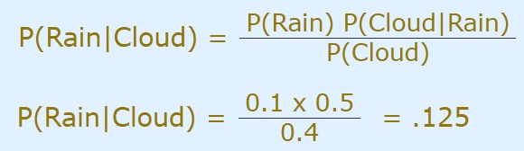
Example of Bayes Theorem
So we can write,
P(Rain) = 10%
P(Cloud|Rain) = 50%
P(Cloud) = 40%
So you know that the probability of rain today is only 12.5%, so even if you are not afraid to see the clouds, you can have a picnic because the chances of rain are very low!
rain=0.1
cloud=0.4
cloud_given_rain=0.5
bayes(rain,cloud,cloud_given_rain)
def bayes(a,b,ba):
ab= a*ba/b
print("P(A | B)=",round(ab, 3))

